Slide 1
Web Development
By Prashant Rawat

Slide 2
Tools and Technologies
Technologies
Tools
HTML
CSS
JavaScript
Nodejs
VS Code
Chrome (any browser)
Git bash

Slide 3
HTML (HyperText Markup Language)
<!DOCTYPE html>
<html lang="en">
<head>
<title>Document</title>
</head>
<body>
<p>This is a paragraph</p>
</body>
</html>
Structure
Labels/Tags
Display
DOM (Document Object Model)

Slide 4
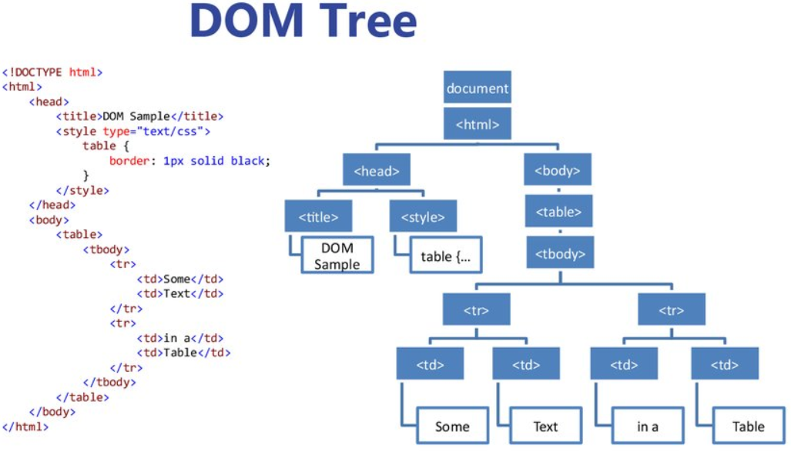

Slide 5
CSS (Cascading style sheets)
body{
background-color: blue;
}
p{
text-align: center;
}
h1{
color: red;
}
Styling
Multiple pages
Bootstrap

Slide 6
CSS Frameworks
Bootstrap - The most widely used free and open-source CSS framework. It focuses on responsive, mobile-first front-end web development.
Alternatives:
Foundation
Pure
Bulma

Slide 7
JavaScript
function abc(a, b) {
return a * b;
}
// storing the value
const c = abc(10, 20);
//logging the result
console.log("Result: " + c);
Responsive
DOM manipulation
Front and Back End
Easy to understand

Slide 8
Nodejs
const express=require("express");
const app=express();
app.use(express.static("public"));
app.listen(3000,function(req, res){
console.log("port 3000");
});
app.get("/",function(req,res){
res.sendFile("index.html");
});
Run-time environment
Uses javascript
Server-side scripts

Slide 9
NPM(Node Package Manager)
express
body-parser
nodemon
monogodb
jimp
ejs
Millions of packages
Easily integrated into projects

Slide 10
Database
MongoDB
MySQL
JSON(JavaScript object notation)-like documents.
Individual records are stored as documents inside collections.
NoSQL
RDBMS (Relational Database Management System)
Individual records are stored as rows inside tables.
SQL

Slide 11
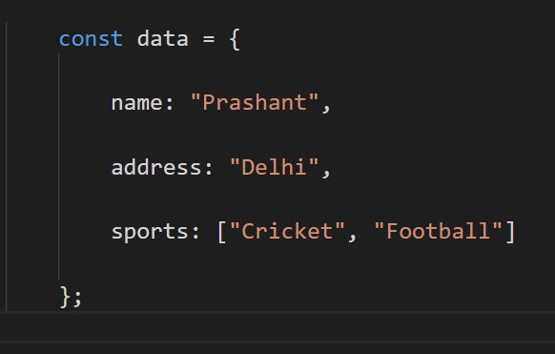

Slide 12
ReactJs
JSX
Components
Virtual DOM
Simplicity
Performance
Front-end JavaScript library.
Offered by Meta.
Single Page App.

Slide 13
Web Development v/s Web Designing
Front-end
Back-end
Full stack developers
User Experience (UX)
User Interface (UI)
Visual Designer

Slide 14
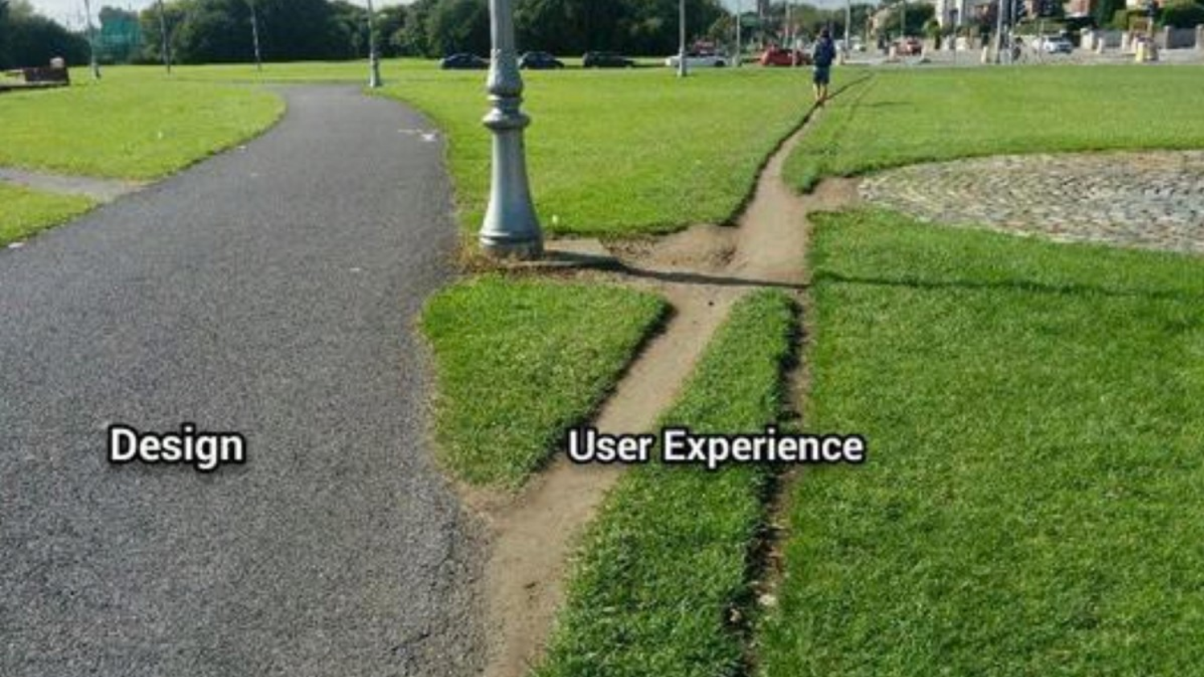

Slide 15
Let's jump to coding …

